Slide 1
Top
Design
Flaws
_{--Sri Harsha, CyberEye.}

Slide 2
Top Design
Flaws?
•
Our focus on principles and rules aims to avoid
security flaws!
•
We’ve seen several examples of flaws so far
Recent launch: IEEE Center for Secure Design
•
•
Comprises top security professionals in industry,
research, and government
Center’s initial focus: What are the top security design flaws in software?
•
http://cybersecurity.ieee.org/center-for-secure-design.html

Slide 3
Top
10
Flaws: Do not
…
1.
2.
Assume trust, rather than explicitly give it or award it
Use an authentication mechanism that can be bypassed or
tampered with
Authorize without considering sufficient context
Confuse data and control instructions, and process control
instructions from untrusted sources
Fail to validate data explicitly and comprehensively
Fail to use cryptography correctly
Fail to identify sensitive data and how to handle it
Ignore the users
Integrate external components without considering their
attack surface
Rigidly constrain future changes to objects and actors
3.
4.
5.
6.
7.
8.
9.
10.

Slide 4
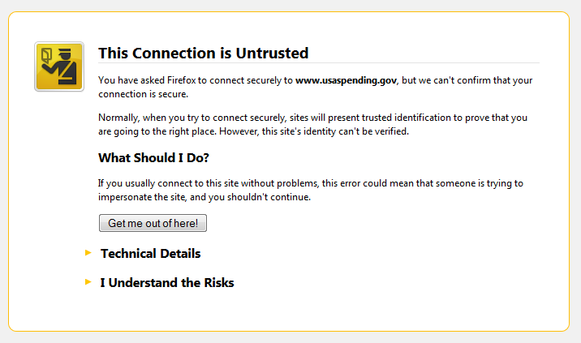
Failure: Authentication
Clients coerced to accept
invalid SSL certificates!
Bypass
•
Bypasses client
authentication of server: Am I really talking to my bank, or a site pretending to be my bank?
!
Web browser presents a warning!
•
•
•
But how many users will
“click through?”

Slide 5
Failure: Authentication Bypass
•
Mobile apps use SSL behind the scenes; what
happens when an app gets an invalid certificate?
•
“While it is understandable that developers turn off
SSL certificate validation in the development phase,
these developers basically forgot to remove their
accept-all code when they released their apps.”
Fahl et al, “Rethinking SSL Development in an Appified World”, CCS’13 (NSA 2014 Best Cybersecurity Paper competition, honorable mention)
!
-
•
Remember: Security is not a feature!
•
Need to test what should not happen

Slide 6
Failure: Authentication Bypass
•
Authentication tokens with long timeouts!
•
Motivates brute-force attempts to steal session cookies
Recall Twitter auth_token failure from web security unit
But can’t make it too short, or will irritate users
-
•
In general: avoid authentication bypass by developing good abuse cases, violating assumption of unique knowledge or possession
•
•
How might an adversary learn a password? Spoof a
biometric? Steal a session ID?

Slide 7
Failure: Bad (or Wrong) Crypto
•
(I repeat) Don’t roll your own crypto!
•
Per use-community-resources examples: both design
and implementation are hard to get right
Don’t assume it gives you something it doesn’t!
•
Encryption algorithm may protect confidentiality but not
integrity. Hashing protects integrity but not confidentiality.
Know how to use it properly!
•
•
•
Use properly generated keys of sufficient size!
Protect the keys from compromise!
Don’t hard-code them, or embed them in released binaries
•
-

Slide 8
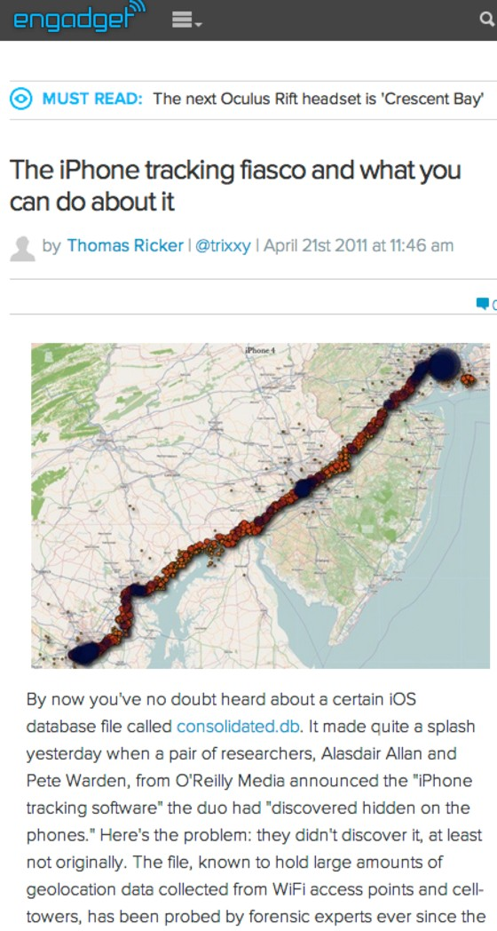
Failure: Ignore which data is sensitive
•
Think carefully about data sources: Which
require protection?
•
Personally identifiable information, sensor
readings, cryptographic keys, session tokens,
geolocation data, …
Failure: private data exposed to general access
-
!
How are these data sources exposed?!
•
•
When at rest, when in transmission, … what is
the threat model?
Failure: embedding authentication token in exposed URL
-
!
How does data, and its exposure, change as
the application evolves over time?
•

Slide 9
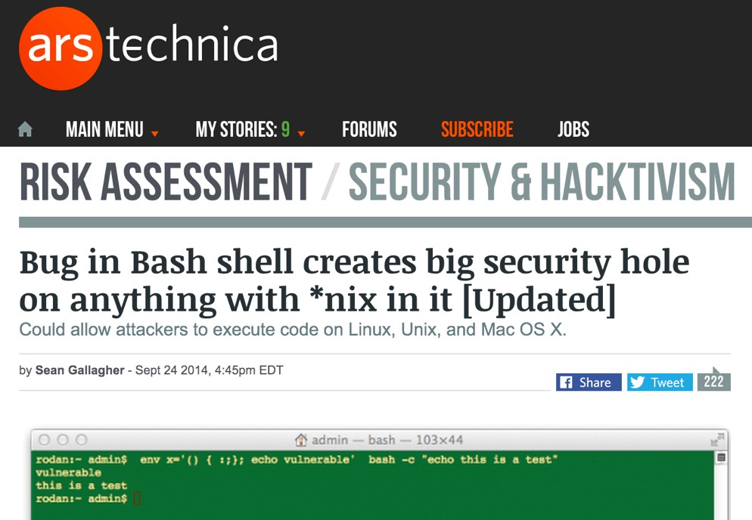

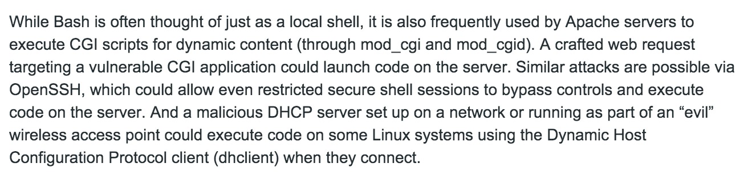
Shellshock Failure: “Bourne
again shell” (bash) — used by web sites (for CGI) DHCP, and other functions — is far more powerful than necessary for these tasks
⁻ Thus: failure in bash leads a serious network-facing vulnerability

